Slide 1
Why your ERP is NOT delivering and how to fix IT
James A Robertson and Associates
Effective Strategic Business Solutions
4. The Missing Link –
precision engineered strategic configuration
The Real Issues in World Class ERP and the Critical Factors for ERP Investment Success
Dr James Robertson PrEng
Copyright 2004 through 2013
James@JamesARobertson.com
Notes:
NB remember to have a chair to stand on
Make sure to take the CRITICAL FACTORS BOOK with you
An engineer with a PhD in engineering

Slide 2
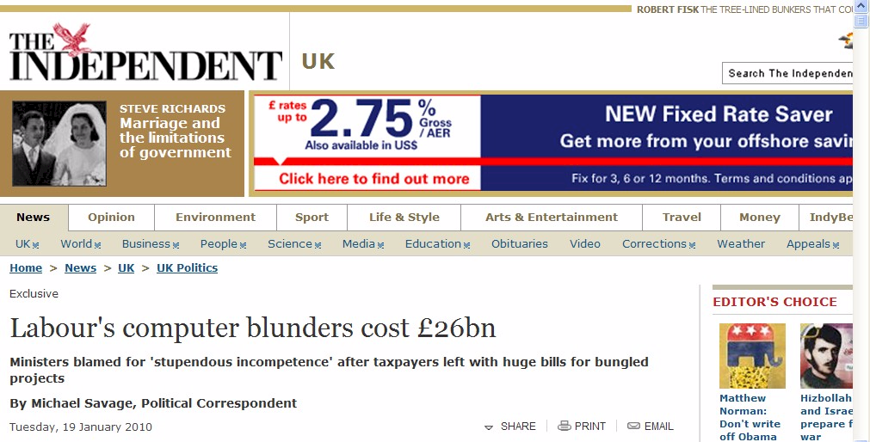
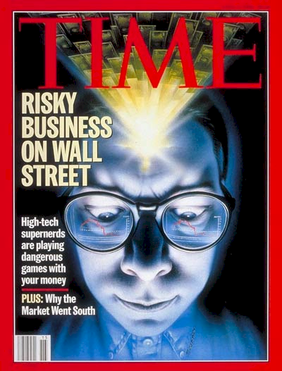
Failures are increasing
The threat and therefore the opportunity is huge

Slide 3
One of the classic business problems of this age
We have spent a FORTUNE on this computer system and I.T. tell me it will take two years and another few million to get what I want BUT the transactions are being processed already

Slide 4
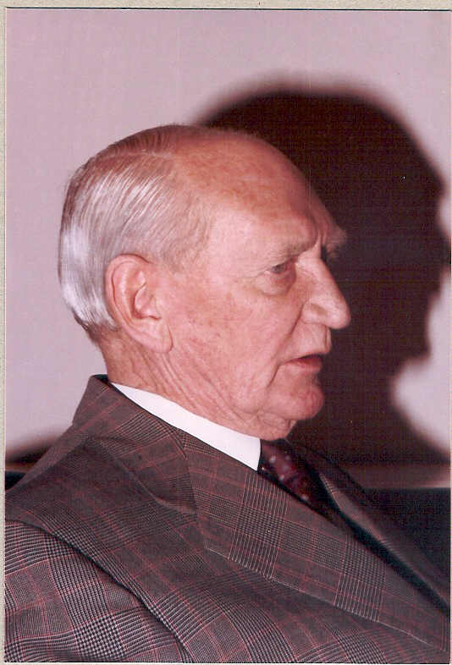
A classic example of IT value
Double turnover in 12 months
I am successful because I make the right recommendations more than 51% of the time
Simple manual models were computerized
Computed faster and therefore many more scenarios
Creative business concept
Better advice in less time to more clients
Doubled turnover in 12 months
In 1982

Slide 5
Precision content engineering Key driver of successful implementations
Days spent with CFO designing the codes -- first year massive improvement in management information, one less clerk, financials signed off without qualifications six WEEKS after month end.
Ten days spent with a director of the company consulting with other directors and managers to design codes -- four clerks instead of 12, an extremely wide range of management information, captured 90% of the data instead of 10%.
Six days spent with CFO’s of operating divisions and major subsidiaries to identify core economic drivers for a group of over 200 companies and develop the headlines of the group consolidation ledger -- dramatic improvement in management information.
The subject of this section is of critical importance -- it is the content that makes the difference

Slide 6
What is an ERP?
“Enterprise Resource Planning” = ERP Systems
? or ?
"Integrated Business Information Systems” = IBIS
= all the information “repositories”
= databases
= tables
= lists
= filing drawers / folders
real world items that require description and management
+ the numerical computations, workflow and other activities that are executed with the numbers (and text) stored in these repositories
ALL of which can be done by human beings -- including making a mess!
R e c a p

Slide 7
Why invest in a new ERP / IBIS? Or any IBIS?
1. Because everyone else has one?
2. Because the one we have does not work very well?
3. Because the one we have is more than five years old?
4. So that we can get better strategic (thrive) information?
5. So that we can get better tactical (thrive) information?
6. So that we can get better operational (thrive) information?
7. So that we have more effective delegation and governance?
8. So that we can become more efficient?
9. Head count reduction and audit fee reduction?
? X No
? X No
XXX NO!!!
Yes
Yes
Yes
Spinoff
Spinoff
Spinoff
To support better decision making

Slide 8
How do you unlock IBIS value?
Value is unlocked through effective delivery of information that is intuitively fundamentally meaningful
Packaged in a way that the computer system APPEARS to be intelligent
Presented through:
reports
graphs
dashboards
advanced statistical techniques
advanced economic analysis
other advanced techniques of information presentation, analysis and interpretation
Resulting in MUCH BETTER strategic, tactical and operational decisions that manifest in improved organizational profitability, growth, impact, etc
High value business decisions

Slide 9
What is the core requirement for any IBIS?
I can get answers to any question for which I can reasonably expect there to be answers in the databases that I KNOW my organization has
Easily and quickly and without major effort on the part of any staff member or contractor
The RIGHT information at the RIGHT place at the RIGHT time in order to make the RIGHT decision
High value intelligent information

Slide 10
How is value created
Value is created by business actions that deliver on the essence of why the organization exists and how it thrives
Value manifests through increased profitability, growth, acquisitions, job satisfaction, fulfilment of the strategic vision
The consequence of intuitive, intelligent, informed leadership business decisions – thrive decisions
Such decisions are facilitated, accelerated and enhanced through access to more intelligent, meaningful and relevant information
Answers to the questions I have not yet thought to ask
Such “intelligent information” is assembled as a consequence of high level strategic and executive level input into the design of the data CONTENT – taxonomies designed to catalogue every conceivably relevant classification ahead of time
High value intelligent content design

Slide 11
Precision strategic content engineering
The definition of information content
in a way that is structurally (taxonomically) fundamentally meaningful to human beings who understand the business
and the translation of this content into structured codes which faithfully and accurately reflect human understanding of the REAL WORLD in a way that the computer can manipulate
with minimal human intervention
so that the computer system appears to be intelligent

Slide 12
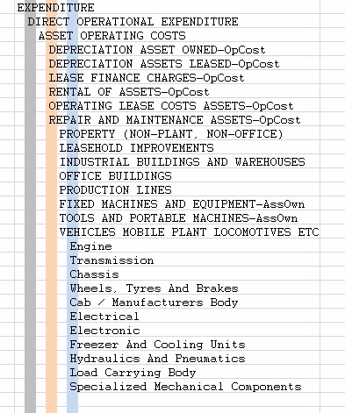
Taxonomy defined
Logical word (semantic structure)
Precision vocabulary of preferred terms
Conveys understanding between humans with relevant knowledge and experience
Once linked to a precision code scheme the most important communication mechanism between computers and people
An art and a science
Once it is right it is OBVIOUS ☺

Slide 13
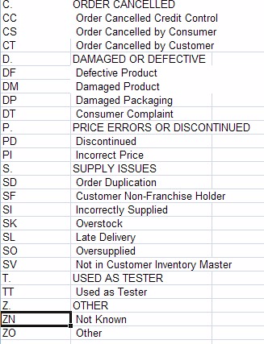
Taxonomy relevance
Essential to effective operational and strategic use of business software
Nearly ALL validation lists (drop down lists), chart of accounts, etc
Large body of expertise – Botany, Zoology, military filing, Library Science, Information Management, etc
Unknown to many (most?) IT professionals and business people

Slide 14
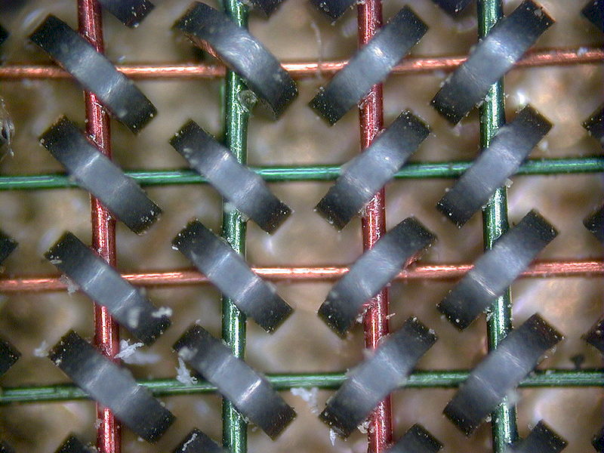
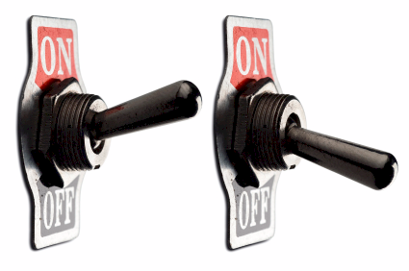
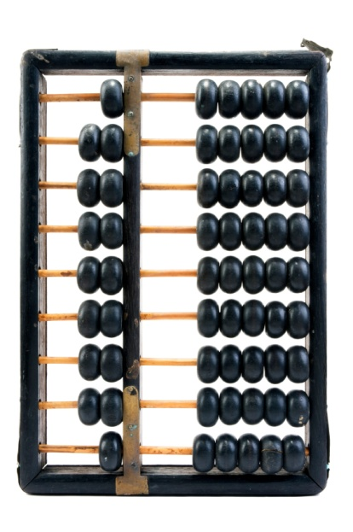
A computer is
An adding machine / calculator
0
1
1+1=10
1+1+1=11
1+1+1+1=100
Called a “bit”
8 bits make a byte
2 bytes make an ASCII character
A= “41” hex
0
1
Notes:
DHL, Prochem,

Slide 15
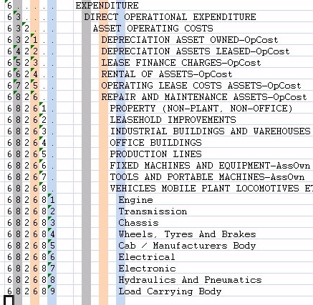
Coding taxonomies
Computers only understand binary
The code is a unique binary pattern that corresponds to the structured English taxonomy
The only way the computer will appear to be intelligent
Results in “intelligent data”
Standard conventions
Indents and trailing periods
2. Capitalization
3. Other standards and conventions

Slide 16
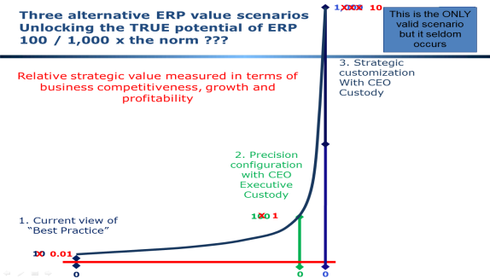
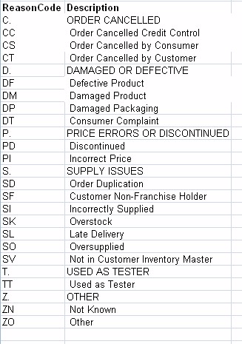
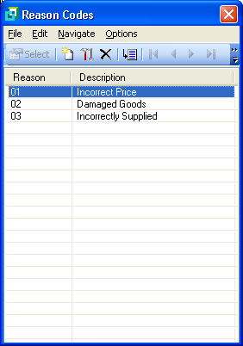
Taxonomy example
Example of poor credit note reason codes – actual case
Strategically aligned credit note reason codes

Slide 17
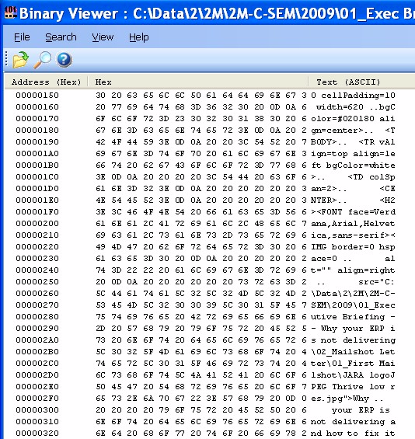
Software and data
text -> hexadecimal -> binary
All for US ☺
Notes:
DHL, Prochem,

Slide 18
What is a general ledger?
Notes:
You understand the technology well enough to manage it
VERSUS ABDICATION / DISEMPOWERMENT
FAST
Computers are simply adding machines or switches that switch left or right – 0 or 1 – on or off – called binary – they just do things very quickly, everything you see is a pattern of 0’s and 1’s – a very fast Abacus – the content is always the same – binary code -- source code is simply instructions for the bricklayer
Wordprocessors are typewriters -- The typing story – so why do you want to spend thousands of Rands upgrading your typewriter every few years? -- Databases are filing cabinets or warehouses -- General ledgers are large books that book keepers write in – networks are postal systems – large frame pictures cost a lot and take up lots of space

Slide 19
What is a general ledger for?
?
X
?
X
R/$
Notes:
You understand the technology well enough to manage it
VERSUS ABDICATION / DISEMPOWERMENT
FAST
Computers are simply adding machines or switches that switch left or right – 0 or 1 – on or off – called binary – they just do things very quickly, everything you see is a pattern of 0’s and 1’s – a very fast Abacus – the content is always the same – binary code -- source code is simply instructions for the bricklayer
Wordprocessors are typewriters -- The typing story – so why do you want to spend thousands of Rands upgrading your typewriter every few years? -- Databases are filing cabinets or warehouses -- General ledgers are large books that book keepers write in – networks are postal systems – large frame pictures cost a lot and take up lots of space

Slide 20
Integrated system
(look-up and posting)
Plant
Management
Projects
Inventory
Production Planning
Human Resources
General Ledger
Etc, etc, etc
Asset Register
Accounts Payable
Cash Book
Accounts Receivable
Financial amounts R / $/ etc
People related names, rates, etc
Production related shifts, batches, etc
Precision fundamental strategic taxonomies – the missing link
Notes:
You understand the technology well enough to manage it
VERSUS ABDICATION / DISEMPOWERMENT
FAST
Computers are simply adding machines or switches that switch left or right – 0 or 1 – on or off – called binary – they just do things very quickly, everything you see is a pattern of 0’s and 1’s – a very fast Abacus – the content is always the same – binary code -- source code is simply instructions for the bricklayer
Wordprocessors are typewriters -- The typing story – so why do you want to spend thousands of Rands upgrading your typewriter every few years? -- Databases are filing cabinets or warehouses -- General ledgers are large books that book keepers write in – networks are postal systems – large frame pictures cost a lot and take up lots of space

Slide 21
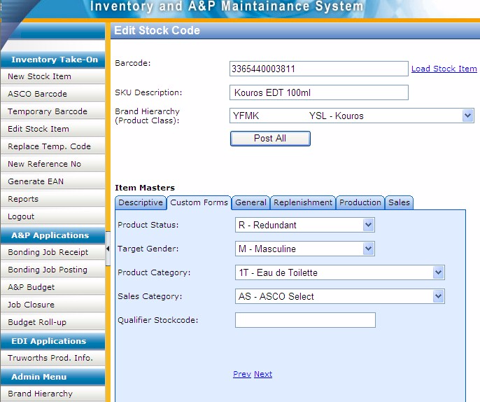
Custom data entry screen with custom taxonomies
Notes:
DHL, Prochem,

Slide 22
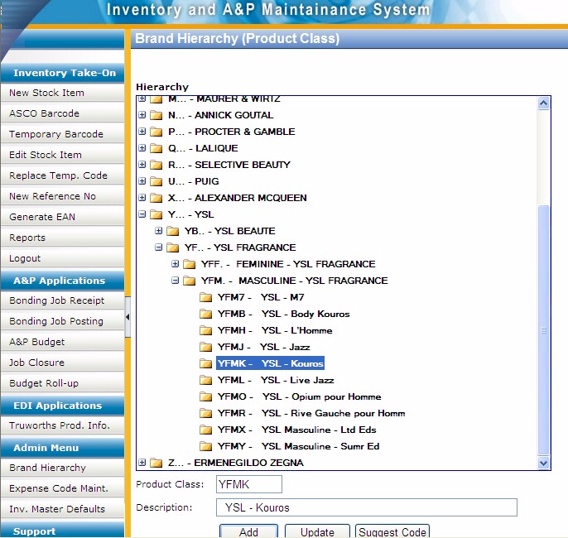
Custom code maintenance development for client specific taxonomy
Notes:
DHL, Prochem,

Slide 23
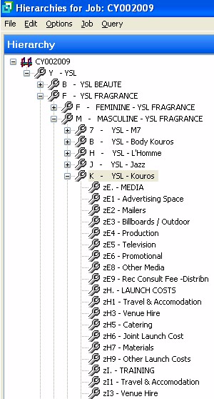
Matching codes in unrelated module provide logical integration
Getting the software to do what it supposedly cannot do
Notes:
DHL, Prochem,

Slide 24
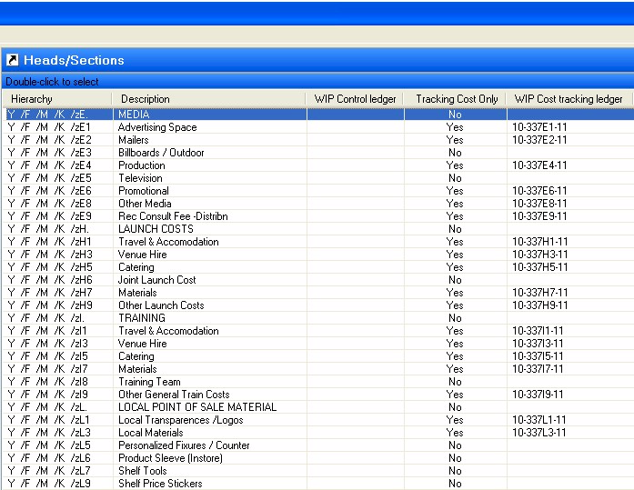
Example of faulty integration
“The &$%^#@% system lost my data”
Notes:
DHL, Prochem,

Slide 25
Factors causing IT failure
Weak content engineering is the most tangible factor causing failure
Notes:
NB People
KEEP IT SHORT

Slide 26
The Business Intelligence
and ERP challenge
Most businesses are NOT making better decisions than they did five years ago despite substantial BI investments -- Gartner 2006
19 out of 20 ERP implementations do not deliver what was promised” – Financial Mail 2003
50% of ERP projects fail – Gartner
Precision strategic content engineering
→ THE MISSING LINK
A HUGE OPPORTUNITY

Slide 27
Business Intelligence
the ideal
Better DECISIONS
Business intelligence solutions
ERP
Precision fundamental strategic taxonomy
The foundation of decision support
The business

Slide 28
Business Intelligence
current reality
Throwing
Money away
Business intelligence solutions
ERP
The business

Slide 29
Business Intelligence
the opportunity
high value highly successful outcomes
Business intelligence solutions
Precision fundamental strategic taxonomies
The foundation of BI – logical translation layer
Years
ERP
Precision strategic business fundamentals
The foundation of decision support
Precision fundamental strategic taxonomy
The foundation of decision support
The business

Slide 30
Value versus precision
A critical consideration
The goal
100%
Business value delivered
Just about every implementation I have ever seen
Practical fundamental strategic taxonomy precision
100%

Slide 31
Key principles of executive level strategic decision making
85% of the basis of executive decision making is soft and tacit information
Skim – headlines
Maximum focus at the start of a report – the first page
80:20 – Pareto – the Critical / Key issues
Fast
Decisive
Right more than wrong
High value
Intuitive

Slide 32
Critical principle – constraint and opportunity -- cognitive span

Slide 33
Drill down
A function of the content

Slide 34
Longevity of the scenarios
Formal best practice data engineering
Mapping within current constrains
Notes:
Been doing for 20 years, done dozens

Slide 35
Cubic business model
A logical taxonomic construct
Every organization has a location logical dimension – where we do what we do
and a functional logical dimension – what we do
These can be plotted on a matrix of function versus location
This is fundamental to the design of a chart of accounts and all other logical components that define the business
There are multiple further dimensions including income, expenditure, personnel, machines, products, etc
Each of these should be described by a fundamental precision strategic taxonomy
This model in the general ledger provides a critical elment of integration

Slide 36
Cubic business model concept
GL or costing module
FUNCTIONAL AXIS
What We Do
LOCATION AXIS
Where We Do What We Do

Slide 37
Financial cube
Essence of integration
Well over 1,000 hours R&D
Projects
etc
People
Products
Assets
Accounts -- financial
Function
Accounts
Location

Slide 38
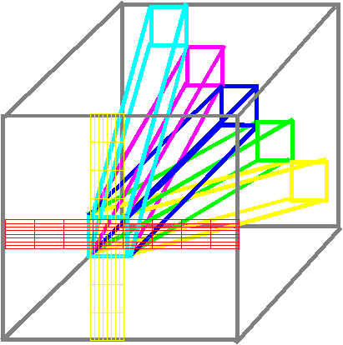
Cubic business model
Locus of integration -- taxonomies
Accounts in the Ledger
Other modules

Slide 39
How integration works around the GL
Other modules

Slide 40
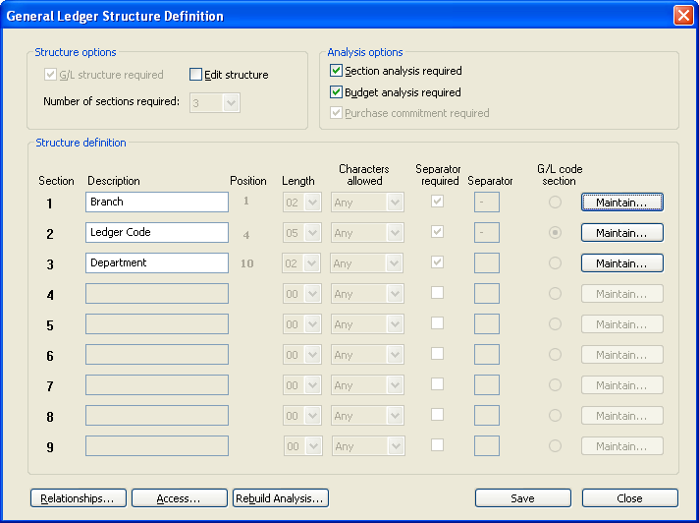
Example of “cubic business model”
In General Ledger
Notes:
DHL, Prochem,

Slide 41
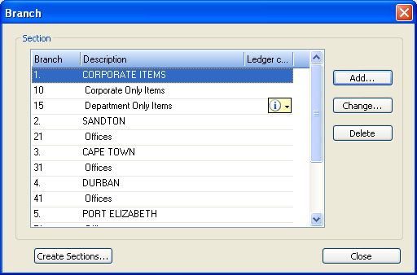
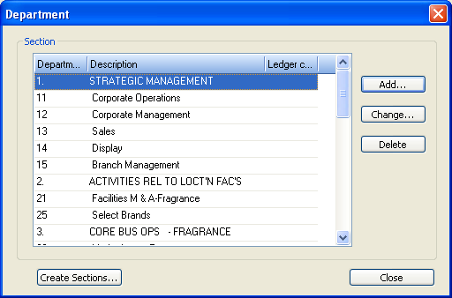
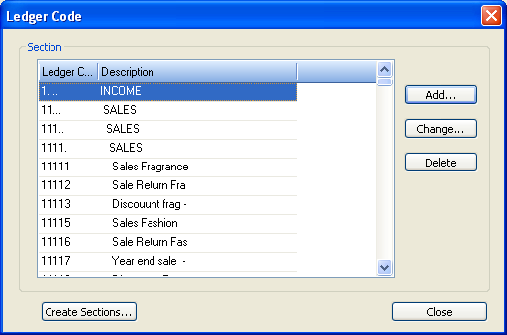
Example of “cubic business model”
Notes:
DHL, Prochem,

Slide 42
Use in acquisitions
Map existing data of newly acquired company onto existing precision strategic taxonomies
Run all available reports against new acquisition within days
Integrate and optimize the new business quickly and efficiently
Use in due diligence investigations also
Function
Accounts
Location
Precision fundamental strategic taxonomies

Slide 43
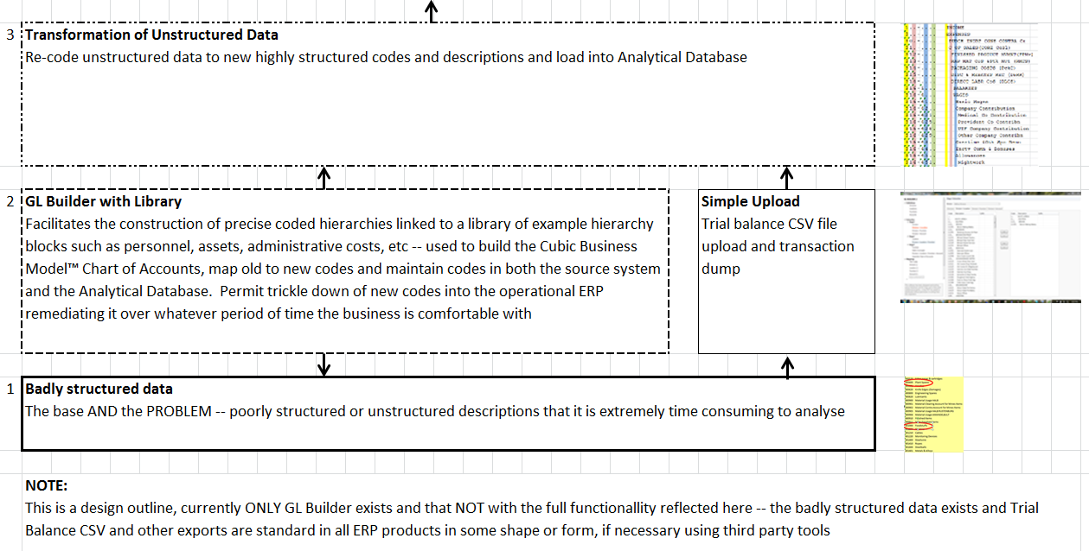
Financial Analysis Suite

Slide 44
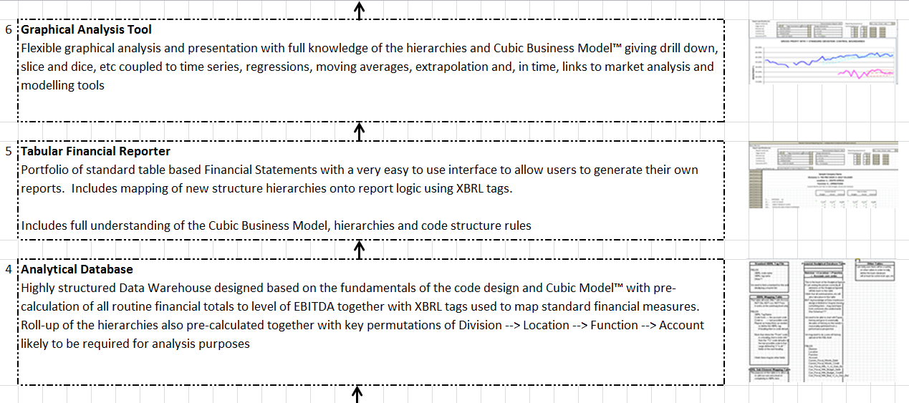
Financial Analysis Suite

Slide 45
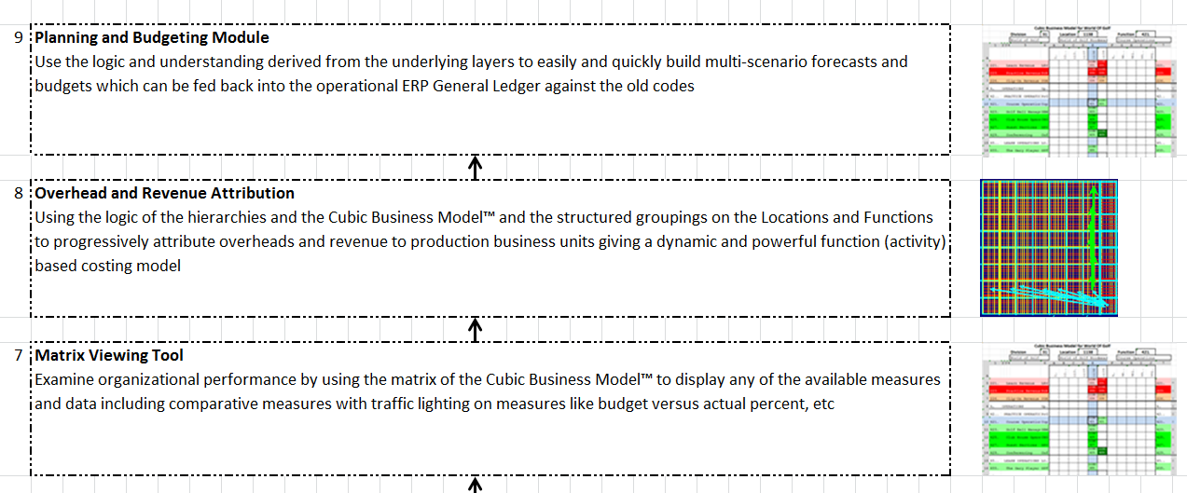
Financial Analysis Suite

Slide 46
Financial Analysis Suite
Broad concept been known to me for over twenty years
I have done some elements semi-manually
For years I thought everyone could understand this and do it
Never seen anything like it
Extremely powerful tool

Slide 47
The true value
Exceptionally high quality financial data
Extremely easy to access and analyze
Facilitate greatly improved high value executive level strategic decision making – the decisions to thrive
Properly used WILL lead to greatly improved competitiveness and profitability
This will enhance profitable growth
Every organization needs this
The current ERP market is estimated at US$56 billion
We can easily capture at least 1% of this over the next ten years – this is THE way of the future

Slide 48
Components of Precision Configuration
Software settings
Cubic Business Model™ in the General Ledger
Asset classification
Product / Material / Item classification / catalogue
Classification of Personnel
Other specific classifications
Unique attributes on Products and other classification master data
General record level attribute settings
9. Other configuration settings

Slide 49
The precision configuration process
Essence of the business
Configuration & integration
Taxonomy config mgmt
Business fundamentals
Basic reports
ERP fundamentals
BI ETL
Dashboards
Develop Hierarchies
Economic & other models
(Assemble)
(Cubes)
Better decisions
THRIVE
Strictly confidential – privileged information

Slide 50
If only I knew exactly what the relative cost of these two machines was I could compete more profitably
Benefits of a comprehensive integrated intelligent information model
Comprehensive integrated economic and operational model
with precision strategic taxonomies
GL
MM
IM
PM
PC
etc
Precision fundamental strategic taxonomies

Slide 51
Characteristics of precision strategic content engineering
Methods and standards
Driven by executive (strategic) decision support requirements
Fundamental first principles → Strategic
Highly structured → Hierarchical
Very specific coding and layout conventions for ease of use
Disciplined code design and maintenance
Massive improvement in management information and decision support
Deliver the often promised but seldom delivered benefits of business ERP, CRM, ECM, BI, IT → business system investments
An opportunity to gear your current investment

Slide 52
What is different about the JAR&A approach to precision strategic configuration – all proprietary
Taxonomy approach immediately engages with executives to specify high level configuration focused on the essence of the business – focus on better decision making NOT process – strategic executive level facilitation – excellent executive engagement and custody
Fundamental focus on better strategic (thrive) decisions at executive and operational level – put the essence (strategy) of the business in the face of staff at all levels constantly
Design geared to answering the questions you have not yet thought to ask – no need for lengthy business requirements workshops
Orders of magnitude improvement in system strategic support value delivery – basis for enabling executives and managers to make much better decisions IF they do the work to interpret and act on the information
Notes:
KEEP SHORT AND SIMPLE
MY FATHER
How did i get involved with computers? – my father was a visionary -- In 1981, having gathered over 7,000 pages of research data for my PhD the University mainframe did not have space to store even one page of data. My father purchased me one of the first desktop PC’s in the days of the Apple and Apricot and 123, etc – at a cost of R12,000 two and a half times my research grants! – I very quickly discovered that there was a HUGE gap between what the salesman told me the computer could do and getting it to do it – so, in that respect, NOTHING HAS CHANGED ☺ -- I then put myself through a self taught computer science programme and learned to program, learned to type and finally wrote an award winning PhD thesis – at the same time I computerized my father’s investment consulting business and we were able to double turnover in twelve months and create an enduring revenue stream that lasted for over ten years because we were able to do things that much larger businesses were not able to do – it was then that I began to understand that the strategic application of information technology COULD deliver great value and one of my greatest frustrations is the extent to which few businesses achieve this potential – the rest of this presentation is about lessons I have learned that I hope will help YOU to make a difference in your business with IT

Slide 53
What is different about the JAR&A approach to precision strategic configuration – all proprietary
Move away from expensive resources constantly maintaining simple reports to developing sophisticated modules that support high value understanding, analysis and decision making
Major improvements in quality of master data and ease of master data maintenance
Systems easier and more efficient to use at a transaction level frequently results in productivity gains and head count reductions, reduction in audit fees, etc
Do things the software vendor does not think are possible and that may create substantial strategic value opportunities
Establish a culture of data precision, in fact a whole culture relating to the way you run your systems
Notes:
KEEP SHORT AND SIMPLE
MY FATHER
How did i get involved with computers? – my father was a visionary -- In 1981, having gathered over 7,000 pages of research data for my PhD the University mainframe did not have space to store even one page of data. My father purchased me one of the first desktop PC’s in the days of the Apple and Apricot and 123, etc – at a cost of R12,000 two and a half times my research grants! – I very quickly discovered that there was a HUGE gap between what the salesman told me the computer could do and getting it to do it – so, in that respect, NOTHING HAS CHANGED ☺ -- I then put myself through a self taught computer science programme and learned to program, learned to type and finally wrote an award winning PhD thesis – at the same time I computerized my father’s investment consulting business and we were able to double turnover in twelve months and create an enduring revenue stream that lasted for over ten years because we were able to do things that much larger businesses were not able to do – it was then that I began to understand that the strategic application of information technology COULD deliver great value and one of my greatest frustrations is the extent to which few businesses achieve this potential – the rest of this presentation is about lessons I have learned that I hope will help YOU to make a difference in your business with IT

Slide 54
Essential elements of the JAR&A approach to precision strategic configuration – all proprietary
Strategic (thrive) decision support – psychology of decision making – strategic elements at top of list; comply with cognitive span equals seven plus or minus two items at any level of hierarchy
Every validation list; custom validation lists; fully describe entities the way the business and executives think about them
Fundamental first principles strategic design with finely granular, highly structured, hierarchically presented content
Ease of reading and navigation – trailing periods, indents, capitalization, precision language – semantic structure – JAR&A originated standards and conventions
Ease of reporting – range coding – ease of report maintenance – context for precision configuration – ease and quality of master data maintenance
Notes:
KEEP SHORT AND SIMPLE
MY FATHER
How did i get involved with computers? – my father was a visionary -- In 1981, having gathered over 7,000 pages of research data for my PhD the University mainframe did not have space to store even one page of data. My father purchased me one of the first desktop PC’s in the days of the Apple and Apricot and 123, etc – at a cost of R12,000 two and a half times my research grants! – I very quickly discovered that there was a HUGE gap between what the salesman told me the computer could do and getting it to do it – so, in that respect, NOTHING HAS CHANGED ☺ -- I then put myself through a self taught computer science programme and learned to program, learned to type and finally wrote an award winning PhD thesis – at the same time I computerized my father’s investment consulting business and we were able to double turnover in twelve months and create an enduring revenue stream that lasted for over ten years because we were able to do things that much larger businesses were not able to do – it was then that I began to understand that the strategic application of information technology COULD deliver great value and one of my greatest frustrations is the extent to which few businesses achieve this potential – the rest of this presentation is about lessons I have learned that I hope will help YOU to make a difference in your business with IT

Slide 55
Essential elements of the JAR&A approach to precision strategic configuration – all proprietary
Creative strategic use of unrelated modules to work together and limited scope creative strategic custom development – the impossible achieved affordably
Cubic business model – a powerful logical “activity based” management model in the General Ledger – powerful strategic decision support benefits with major positive governance impacts and reduced audit fees – JAR&A have custom developed software to assist with this
Lower long term system operating costs coupled with ORDERS OF MAGNITUDE IMPROVEMENT in effectiveness, efficiency and decision support – better thrive (profitable growth decisions) – where the REAL value lies – answer the questions we have not yet thought of
Notes:
KEEP SHORT AND SIMPLE
MY FATHER
How did i get involved with computers? – my father was a visionary -- In 1981, having gathered over 7,000 pages of research data for my PhD the University mainframe did not have space to store even one page of data. My father purchased me one of the first desktop PC’s in the days of the Apple and Apricot and 123, etc – at a cost of R12,000 two and a half times my research grants! – I very quickly discovered that there was a HUGE gap between what the salesman told me the computer could do and getting it to do it – so, in that respect, NOTHING HAS CHANGED ☺ -- I then put myself through a self taught computer science programme and learned to program, learned to type and finally wrote an award winning PhD thesis – at the same time I computerized my father’s investment consulting business and we were able to double turnover in twelve months and create an enduring revenue stream that lasted for over ten years because we were able to do things that much larger businesses were not able to do – it was then that I began to understand that the strategic application of information technology COULD deliver great value and one of my greatest frustrations is the extent to which few businesses achieve this potential – the rest of this presentation is about lessons I have learned that I hope will help YOU to make a difference in your business with IT

Slide 56
Factors for ERP reimplementation success
Strong content engineering is the most tangible factor for success

Slide 57
Summing up
Excellent high value decisions rely on logical strategically aligned information → the information to thrive
To get executive intelligence OUT you must put executive intelligence IN – “intelligent content”
Precision strategic content engineering IS THE missing link in ERP and IBIS
Requires a significant investment
An ART and a science
Do NOT scrap your current system until you have thoroughly evaluated this
An opportunity for dramatic gearing of your current investment
Better DECISIONS

Slide 58
Questions?
Dr James Robertson PrEng
James A Robertson & Associates
Telephone: ++27-(0)86-111-5409 / ++27-11- 782-5996/7
Cell: 083-251-6644 (preferred)
Fax: ++27-(0)86-540-0178
P O Box 4206, Randburg, 2125, South Africa
www.JamesARobertson.com
email: James@JamesARobertson.com
Please remember to complete the evaluation forms
Finding the missing pieces of your I.T. and strategy puzzles

